Slide 1

An Introduction to my Text Mining Project on Zhu Fan Zhi诸藩志
Jiating Liu

Slide 2

Contents
Part 1: What is my source? Why did I choose it?
Part 2: What do I want to get from the source?
Part 3: What are my long-term goals?
Part 4: What are my next steps?

Slide 3
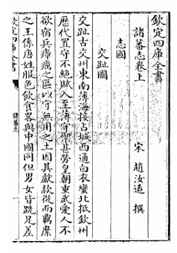
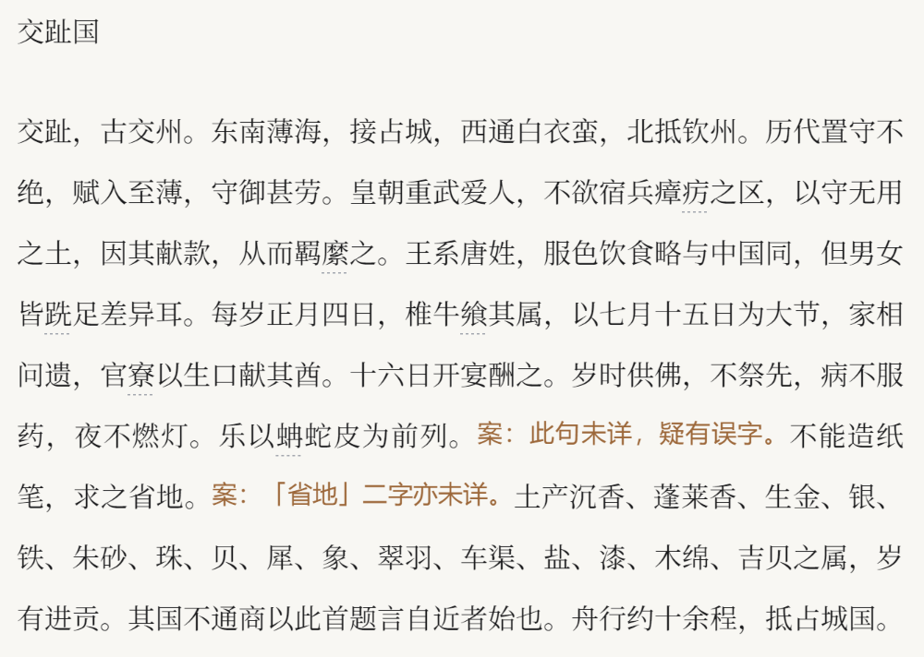
Part1: What is my source? Why did I choose it?
Part1: What is my source? Why did I choose it?
Zhu Fan Zhi (Records of Foreign Nations)- Song Dynasty (960-1279 CE)
Author: Zhao Rukuo

Slide 4
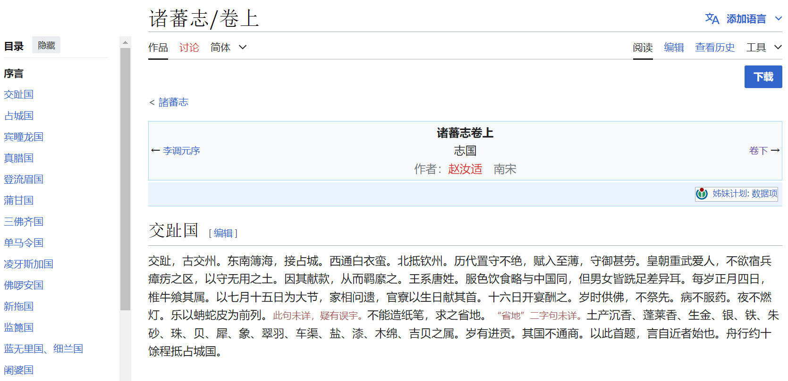
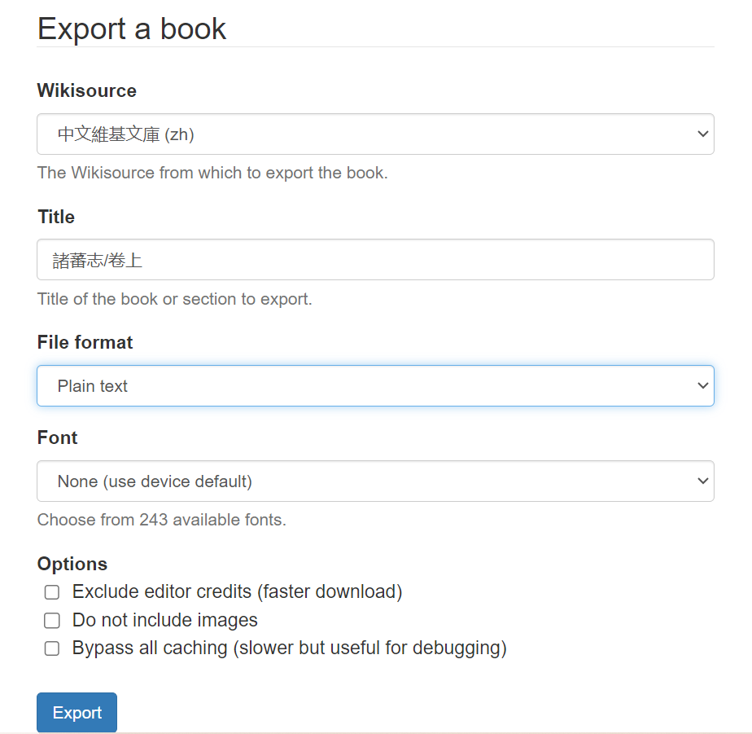
Part1: What is my source? Why did I choose it?
Part1: What is my source? Why did I choose it?
Acknowledgement: This work is in the public domain worldwide because the author passed away more than 100 years ago, and it was published before January 1, 1929. Therefore, it is no longer under copyright protection, and anyone can freely use it.

Slide 5
Part1: What is my source? Why did I choose it?
Part2: What do I want to get from the source?
What names and places are mentioned in Zhufanzhi?
Are there any landscapes (natural or cultural) that have been mentioned, and if so, what are they?
Is there any evidence of trade between Song and Southeast Asia, what kind of commodities/goods are frequently mentioned?
Whether cultural activities (eg. religion) have been demonstrated in the book, and what kind of activities?
Close Reading
What topics frequently were mentioned in the book?
What kind of Sino-foreign network was displayed in the book?

Slide 6
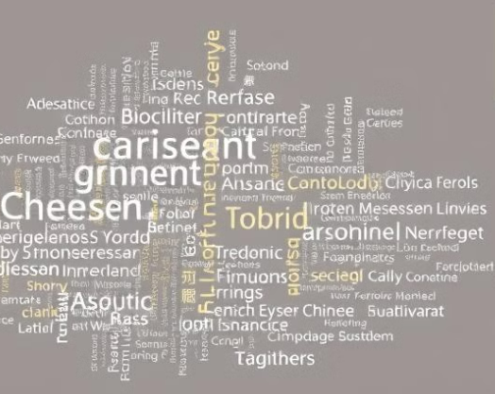
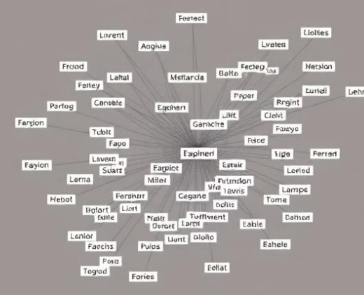
Part1: What is my source? Why did I choose it?
Part3: What are my long-term goals?
What topics frequently were mentioned? (e.g. trade, culture and Sino-Southeast relations)
What kind of Sino-foreign network was displayed?
word frequency analysis
topic modeling analysis (such as LDA)
word co-occurrence
GIS analysis
network analysis

Slide 7
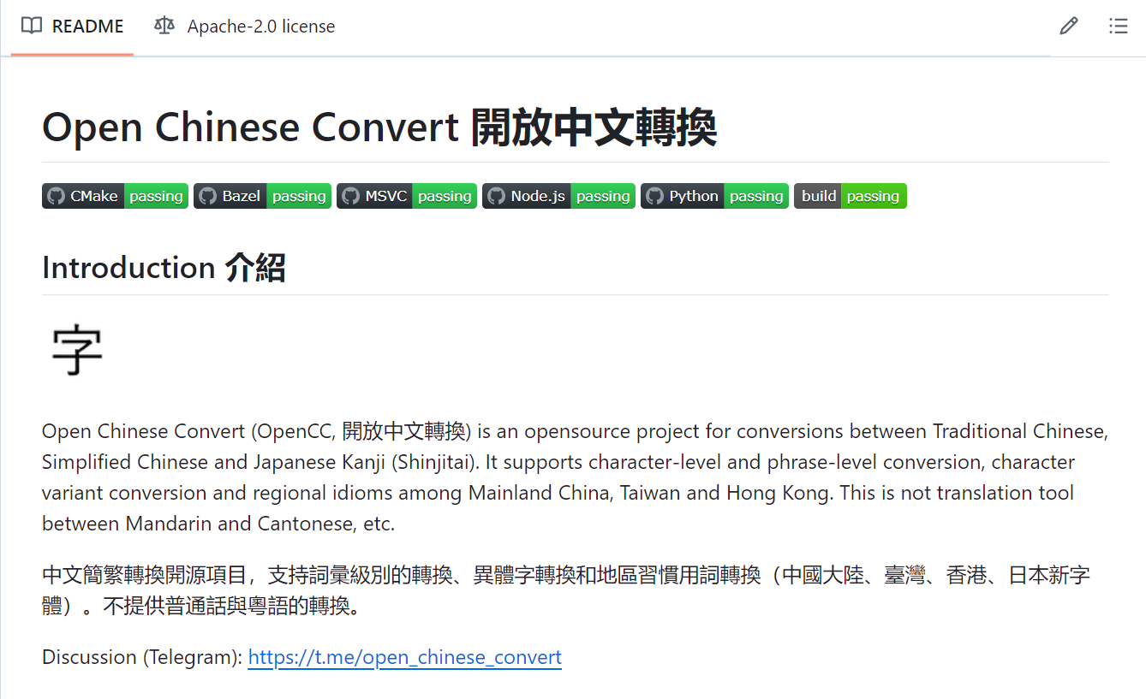
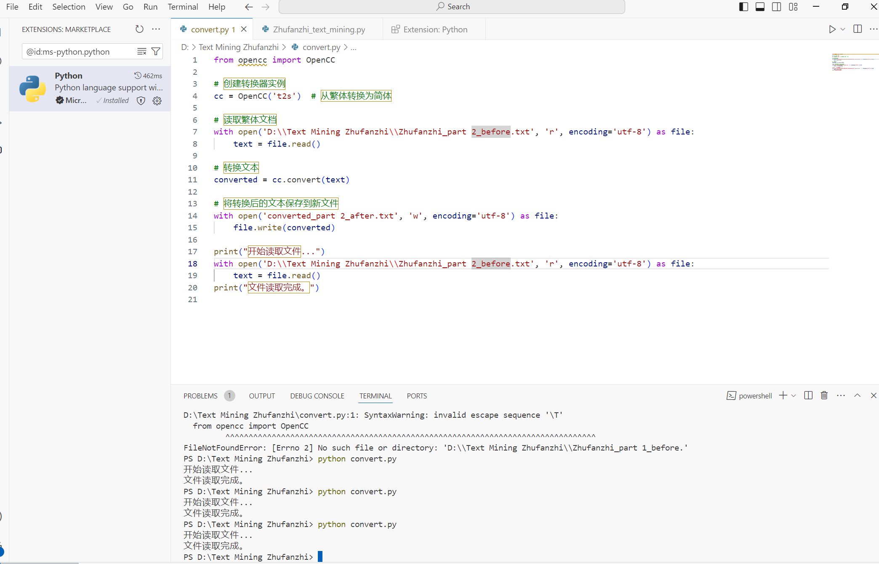
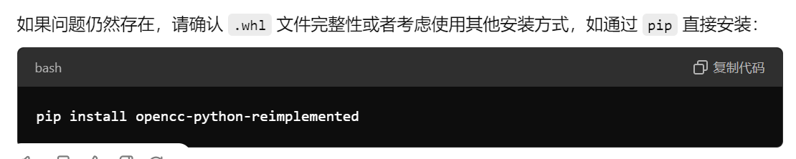
Part1: What is my source? Why did I choose it?
Part 4. What are my next steps?
Conversion between Traditional and Simplified Chinese and Variant Character List

Slide 8
Part1: What is my source? Why did I choose it?
Part 4: What are my next steps?
Next iteration:
Data cleaning process
Word frequency
Topic modeling analysis

Slide 9
Part1: What is my source? Why did I choose it?
Thank you for listening!

